Slide 1


Buckendale Lecture
Transitioning commercial vehicles to zero impact emissions
– Challenges and Opportunities ahead
Dr. Ameya Joshi
Date : September 21st, 2022
joshia@corning.com https://www.linkedin.com/in/joshiav/

Slide 2
Acknowledgments
Julie Blumreiter (ClearFlameEngines)
Matt Fernley (Battery Materials Review)
Vivek Sujan (Oak Ridge Natl. Lab)
Beth Hinchee (Caterpillar)
Shakti Saurabh (Cummins)
Addie Majewski (DieselNet)
Mats Hultman (Neste)
Felipe Rodríguez (ICCT)
Roland Dauphin (Concawe)
Mark Herbst, Tom Waldron (SuperTurbo)
Chris Sharp (SWRI)
Special thanks to the Buckendale Committee for keeping me honest
(and hopefully on time !)
And to my boss, Dr. Willard Cutler, for his mentorship and freedom in working on these topics

Slide 3
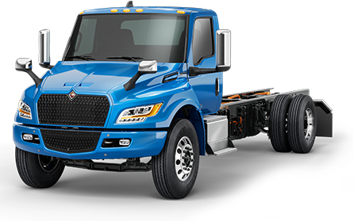
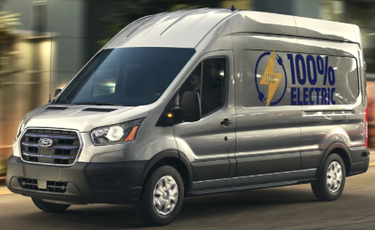
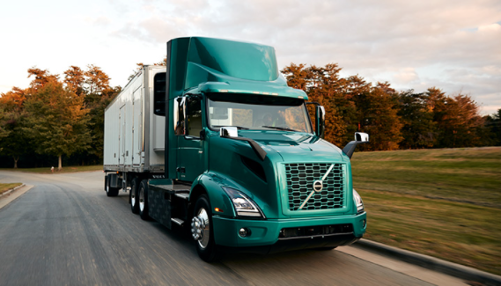
Perception : Electrification is the solution for transport decarbonization
R&D spending and policies are skewed heavily towards ZEVs
Efficiency improvements
SuperTruck 55% BTE
ICE
Alternate fuels
CNG, LPG
Fuels
Electrification
ZEVs
Battery electrics
Fuel cell vehicles

Slide 4
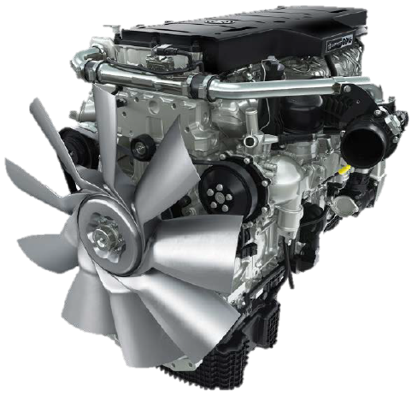
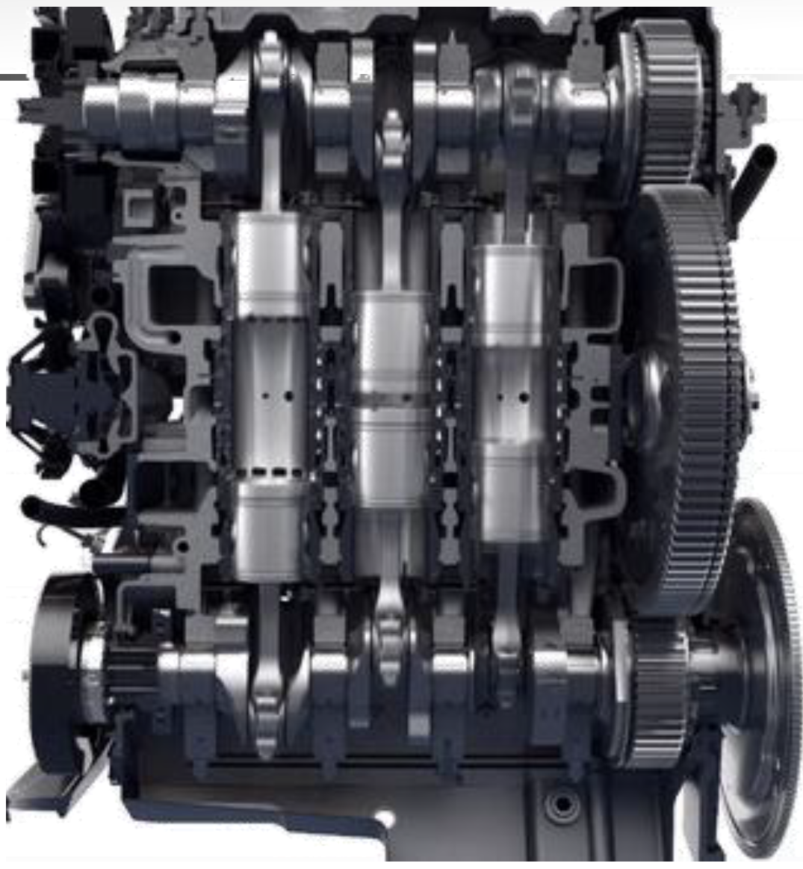
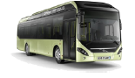
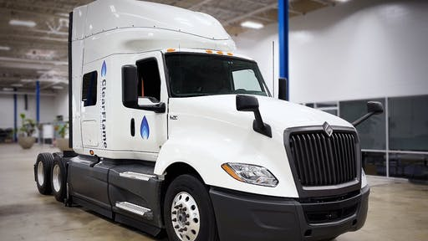
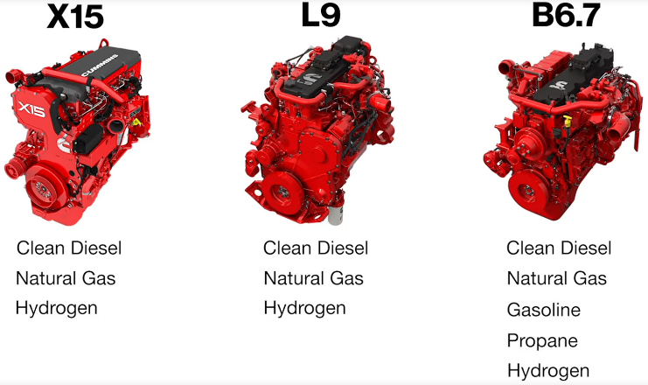
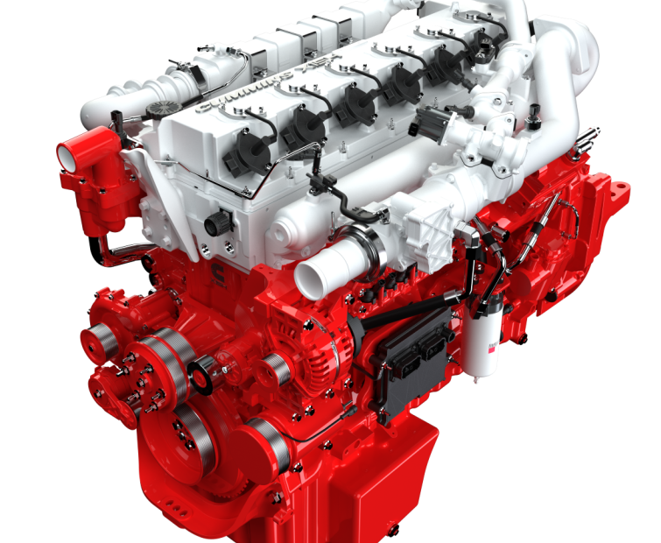
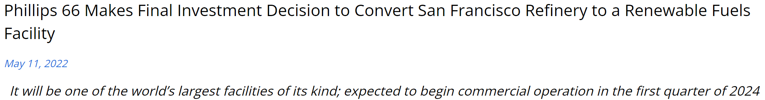
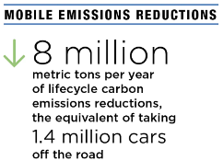
Opinion: We need to pursue all pathways for decarbonization - True ?
Efficiency improvements
55% BTE, Opposed piston
AchatesPower Opposed Piston engine
Detroit DD15, inline 6-cyl
2024 GHG compliant
ClearFlame Engine
Runs on ethanol
Volvo 7900 hybrid
Alternate fuels
CNG, LPG
Ethanol
Fuel agnostic engines
Hybridization
Mild, full hybrid
ICE
Hybrid + green fuel
H₂ ICE
Plug-in + Syn fuel
Cummins fuel agnostic engines
Fuels
Electrification
Cummins 15L H₂ ICE
Low carbon fuels
Renewable fuels
ZEVs
Battery electrics
Fuel cell vehicles
Synthetic fuels
e-diesel

Slide 5



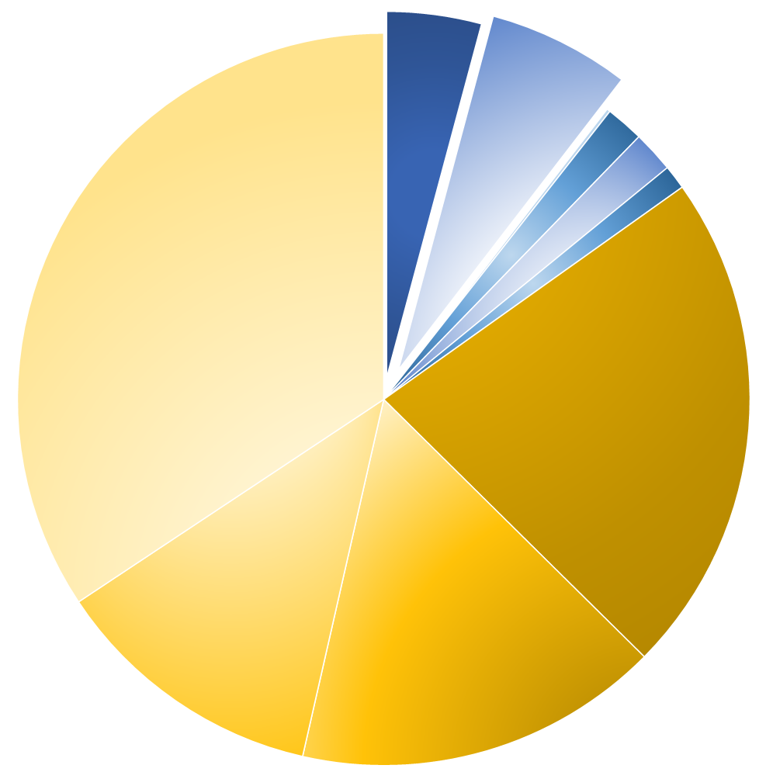
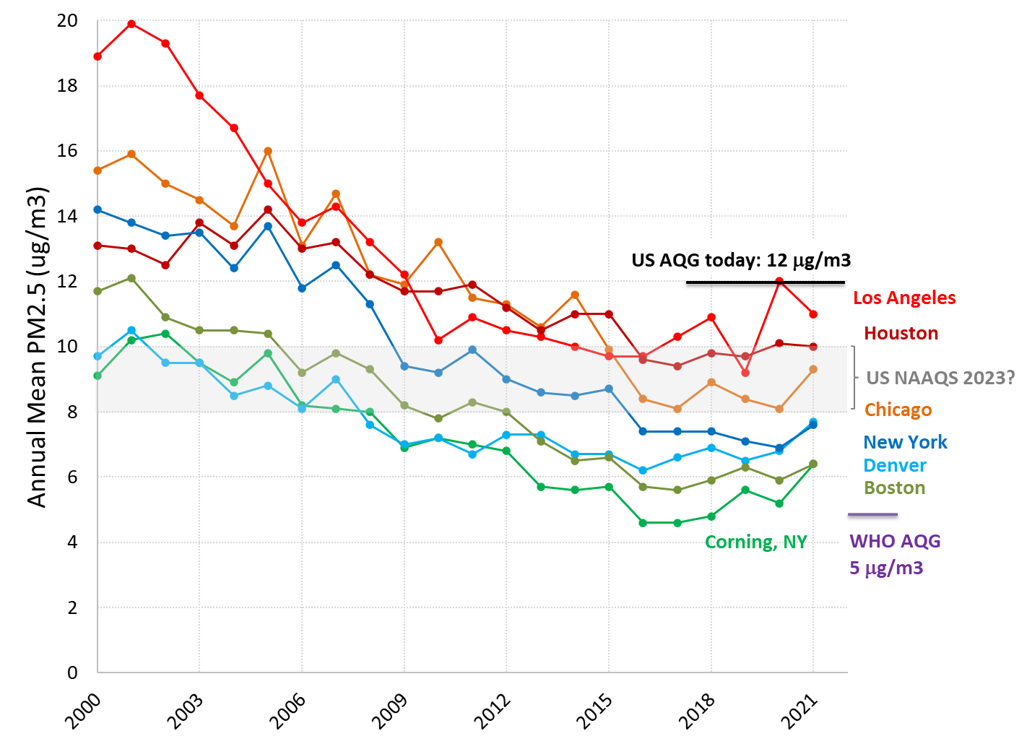




What problems are we are trying to solve in the transportation sector?
Global Greenhouse Gas emissions
Local Criteria Pollutants
We are nearing zero-impact emissions with upcoming regulatory steps (~ Euro 7/VII/EPA Tier 4/Low NOx/CN 7 …)
Freight vehicles (4%)
Cars (6%)
Shipping (2%)
Aviation (2%)
US AQG today : 12 μg/m³
Industry (34%)
Ag., forestry and other land use (22%)
NAAQS 2023?
Energy Supply (12%)
Buildings (16%)
Source: IPCC 2022 https://www.ipcc.ch/report/ar6/wg3/
Source: https://www.epa.gov/air-trends/air-quality-cities-and-counties

Slide 6
Zero impact emissions will require a diverse set of technology solutions
TECH MATURITY & CONSUMER ACCEPTANCE EXISTING INFRASTRUCTURE
Avoid
Shift
Improve
Public transportation
Improved ICE efficiency
Telecommuting
Rail & marine
Hybridization
Geo-fencing
Improved aftertreatment systems
Electrification
Ride-sharing
Light-weighting, aerodynamics etc.
Recycling
Low carbon fuels
Predictive cruise control, platooning
H₂-ICE
Cycling
Waste heat recovery
Urban planning
Fleet turnover
Non-tailpipe emissions

Slide 7

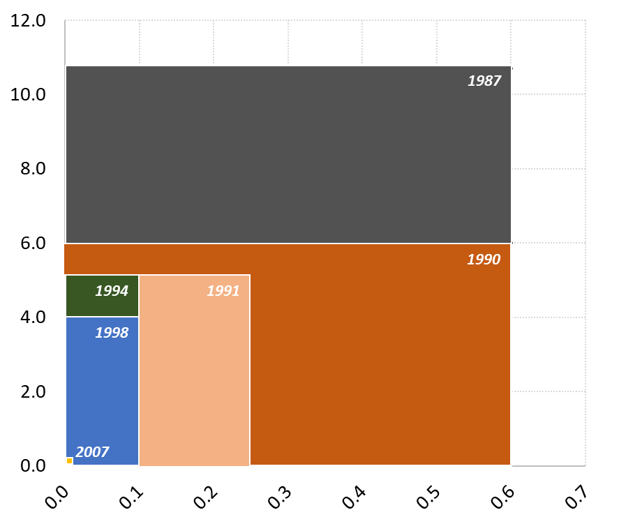
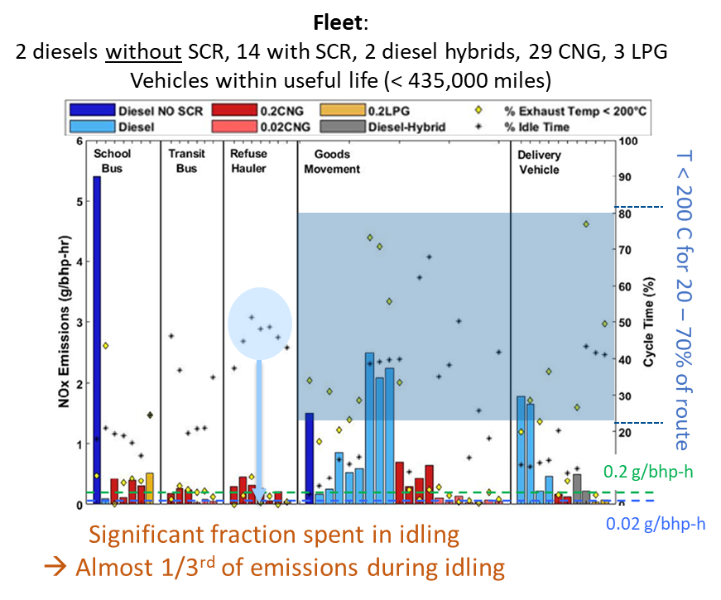
Tailpipe criteria pollutant limits have reduced by >99%
But we need to tackle real-world emission scenarios and high emitters
US EPA heavy-duty diesel tailpipe standards
Fleet emissions study of HD trucks and buses
99.2%
NOx (g/bhp-h)
NOx Emissions (g/bhp-hr)
99.8%
Particle Mass (g/bhp-h)
UC Riverside, SCAQMD https://doi.org/10.1016/j.scitotenv.2021.147224

Slide 8


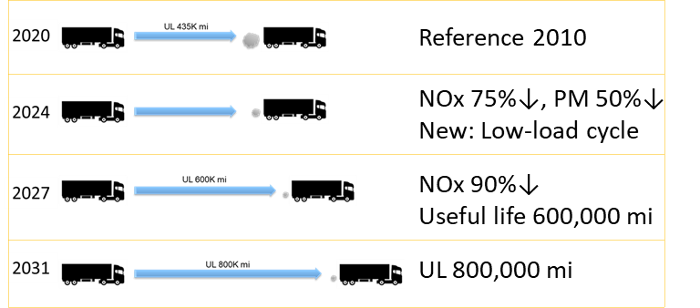
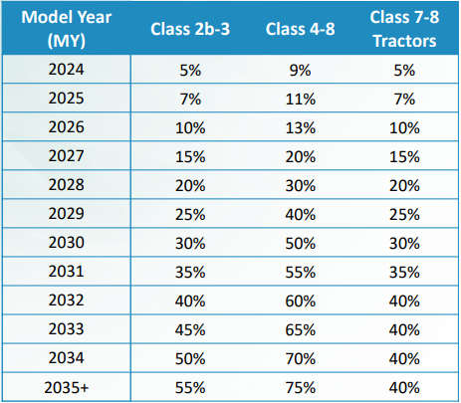
New low NOx regulations will require advancing ICEs
But to BE or not to BE is no longer a question
California Low NOx Omnibus Rule
90% NOx emission reduction by MY2027
California Advanced Clean Trucks Regulation
Manufacturer ZEV* requirements as % of annual sales
+ GHG Phase 2: CO₂ 25% ↓
* ZEVs defined as vehicles with zero tailpipe CO₂ (BEV, FCEV)

Slide 9
Technology for low NOx | Impact on NOx | Impact on CO₂
Engine calibration | Lower engine out NOx | Little / none
Cylinder deactivation | Increased EO temp. → higher NOx conversion | Lower CO₂
Closed crankcase | Lower NOx | Little / none
EGR pump | Better EGR authority | Improved pumping loop efficiency
SuperTurbo | Turbine bypass allows for early SCR warm-up | Engine heating can be offset
Opposed piston | Elevated temp. for early LO | Lower heat loss → lower CO₂
Hybridization | Lower fuel consumption and emissions | Lower CO₂, can offset EHC penalty
Increase SCR volume and catalyst loadings | Improved deNOx at high flow rates | Increased backpressure
Added cc-SCR w/ twin dosing | Early light-off and urea dosing possible | Increased backpressure
+ cc-DOC for NO₂ | Increased fast SCR, slower light-off of cc-SCR | Increased backpressure, N₂O
SCR on filter | Early light off of main (uF) SCR | Passive regen is complicated
Model based A/T controls, NH₃ storage | DeNOx sensitive to level of pre-stored NH₃ | Lower urea consumption
Late & multiple injections | Early light-off | Fuel penalty, increased HC/CO
Heated urea dosing | Early urea dosing, lower deposition risk | Some fuel penalty for heating
Catalyzed DEF solution | Low nitrate deposits, earlier dosing possible | Can eliminate heated dosing
Electrical heater / EHC | Early light-off | Need to manage fuel penalty
Diesel → CNG / LPG / Gasoline / H₂-ICE / … | Lower engine out NOx and/or simpler A/T | Watch for CH₄, H₂ slip
Engine
+ Added SCR
+ Heat
Fuel

Slide 10
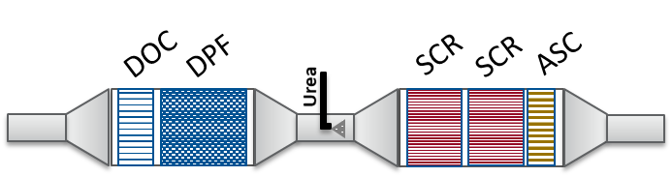
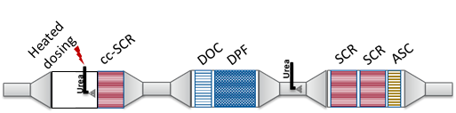
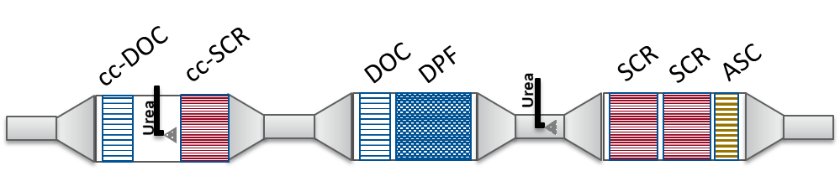
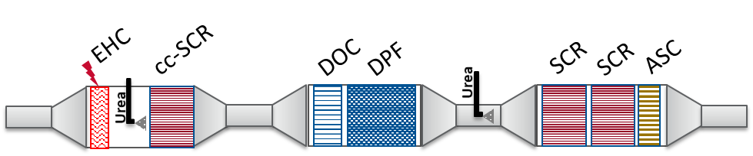
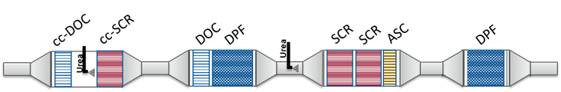
US 2010 / Euro VI | Ref.
CA2027 / Euro VII (example configurations) | 1 2 3 4
*
Advanced technologies
Close-coupled SCR / DOC
Dual NH₃ dosing
Active thermal management – electric heater, heated dosing etc.
SCR on filters
Ultra-high porosity substrates
…
*
*
*
*High filtration DPFs
“Close-coupled” catalysts
Conventional system
2nd filter

Slide 11
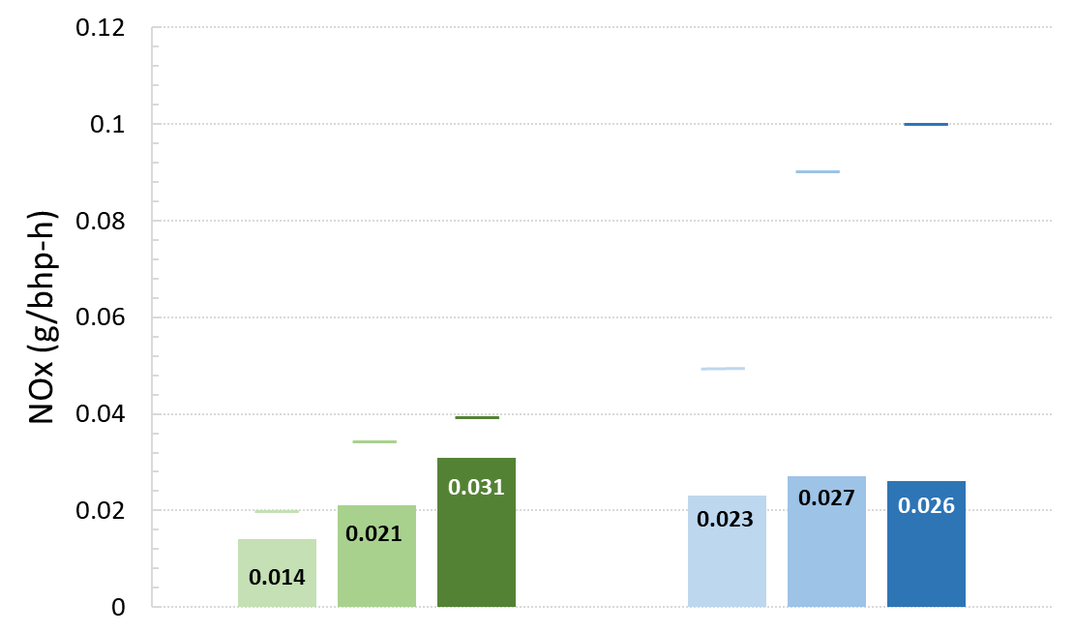
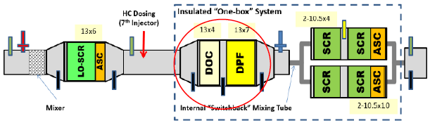
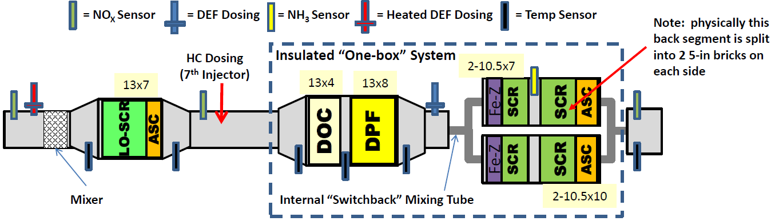
SWRI/CARB study shows pathway to 90% NOx reduction over useful life
SWRI, Vehicle Eff., Electrification & Emissions Conference, 2022
Engine:
Cummins 2017 X15 6-cyl.
+ modified calibration
+ cylinder deactivation
Composite FTP
Corrected for crankcase emissions
Low Load Cycle
Limits
After-treatment: Stage 3 Rework system
20 – 35% margin
435K
600K
800K
435K
600K
800K
Aging (mileage)
+ Improved mixing
CO₂ neutral
+ 1% penalty
Ongoing work:
Testing of EPA Low N₂O system
(hybrid Cu-Fe SCR catalyst)

Slide 12
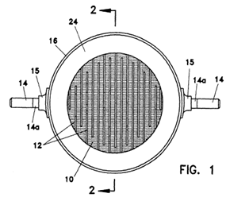
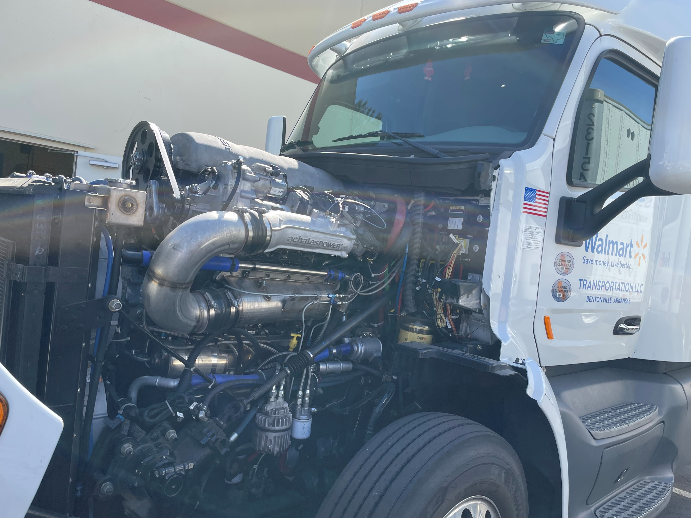
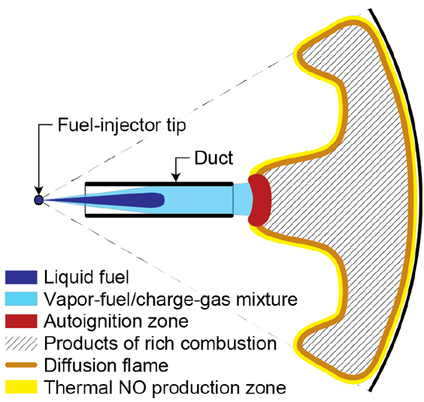
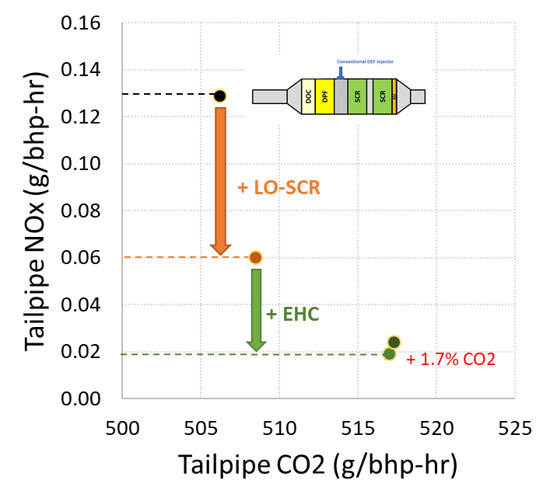
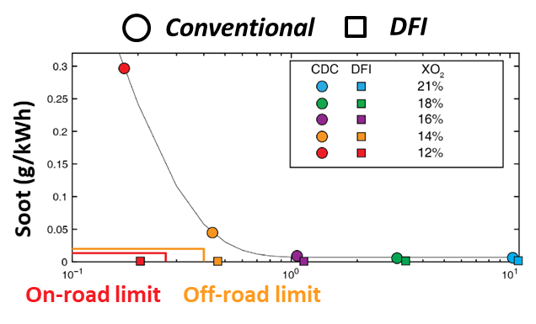
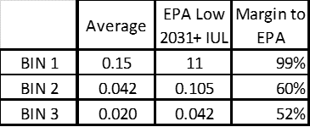
Some more technologies for further reductions in NOx, PM & CO₂
Electrically Heated Catalysts
Opposed piston engine
Ducted Fuel Injection
Electric Heater
P < 7 kW
Fleet demonstration (Walmart)
890 Miles, > 3 days
Fuel economy 6.7 – 10.8 mpg
EPA 3-Bin Analysis of PEMS data
2031+ EPA proposed low limit met with >50% margin with aged catalysts
Four-duct DFI in optical engine @ 1200 rpm
PM (g/kWh)
NOx (g/kWh)
SWRI, Eaton, Corning Front. Mech. Eng 8:979771
doi: 10.3389/fmech.2022.979771
AchatesPower
32nd Real World Emissions Workshop, 2022
Sandia Natl. Lab
SAE Int. J. Engines 13(3):345-362, 2020

Slide 13

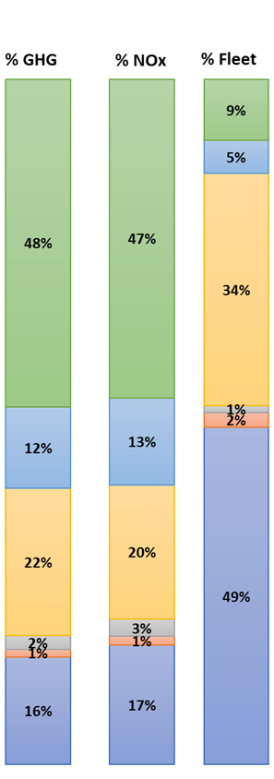
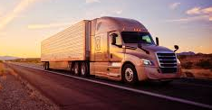
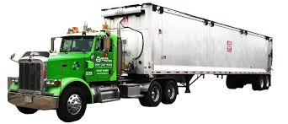
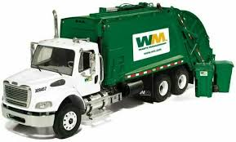
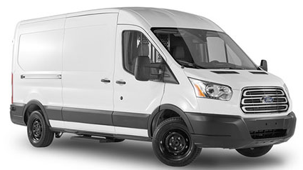
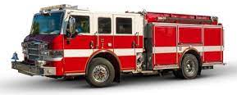


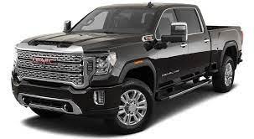
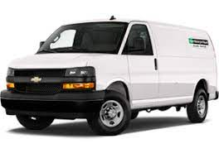
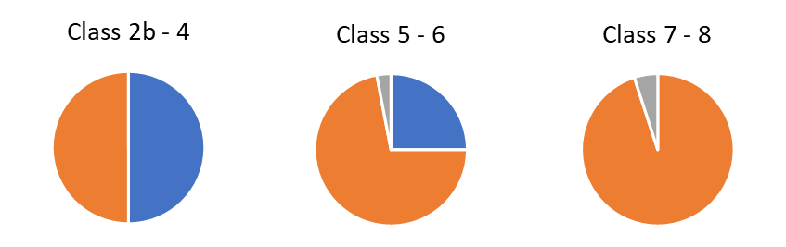
Heavy duty engines serve diverse vehicle applications
- Decarbonization will require a range of technology solutions
Vehicle Class
Total in-use ~ 23 million
Long haul tractor ~ 300 - 500 mi
Class 7 - 8
Regional haul tractor
~ 150 – 300 mi
Class 3 - 7
Vocational ~ 50 – 150 mi
Transit bus ~ 150 mi
Class 7 - 8
School bus ~ 100 mi
Class 2b - 3
HD pickup / van ~ 50 – 75 mi
Diesel
Gas
Other
Fuel type

Slide 14
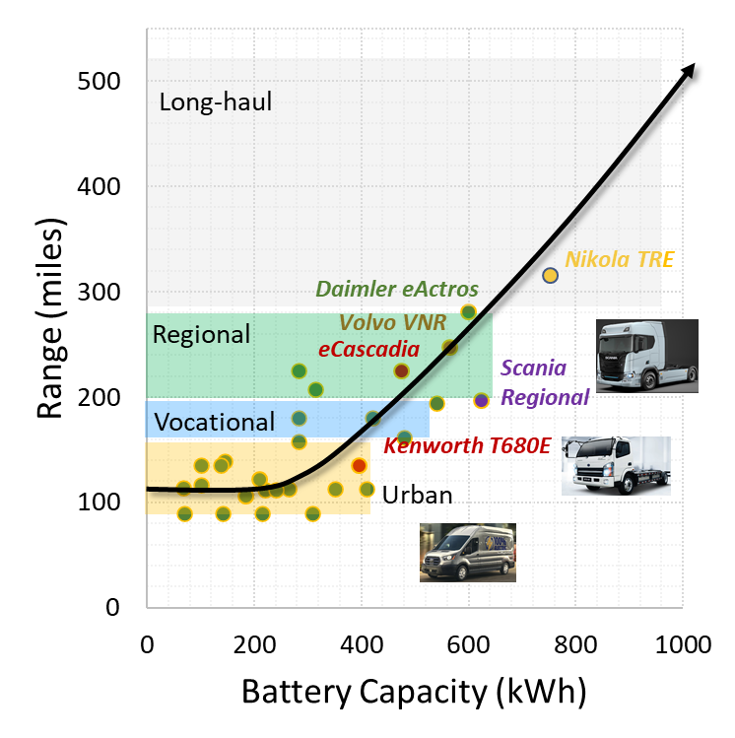
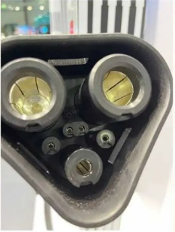
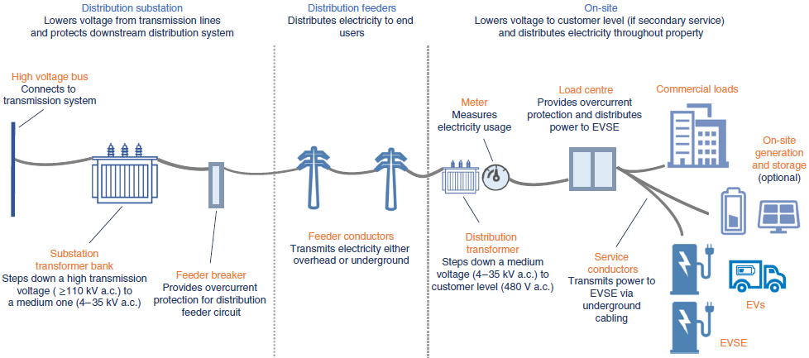
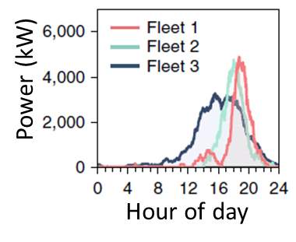
Vocational and regional delivery trucking is well poised for electrification
Long-haul – need to address battery weight, charging time, infrastructure
> 1MWh battery pack needed for 500+ mile range
Charging infrastructure will have to be developed
~ 2kWh/mi*
MW charging needed
Case study
Fleet of 100 vocational EV trucks
4.5 MW peak power for immediate (end-of-shift) charging at 100 kW
78 – 86% substations can supply without any upgrades
* 2kWh/mi →6 hrs overnight depot charging @ 100 kW for 300 mi
NREL https://doi.org/10.1038/s41560-021-00855-0

Slide 15


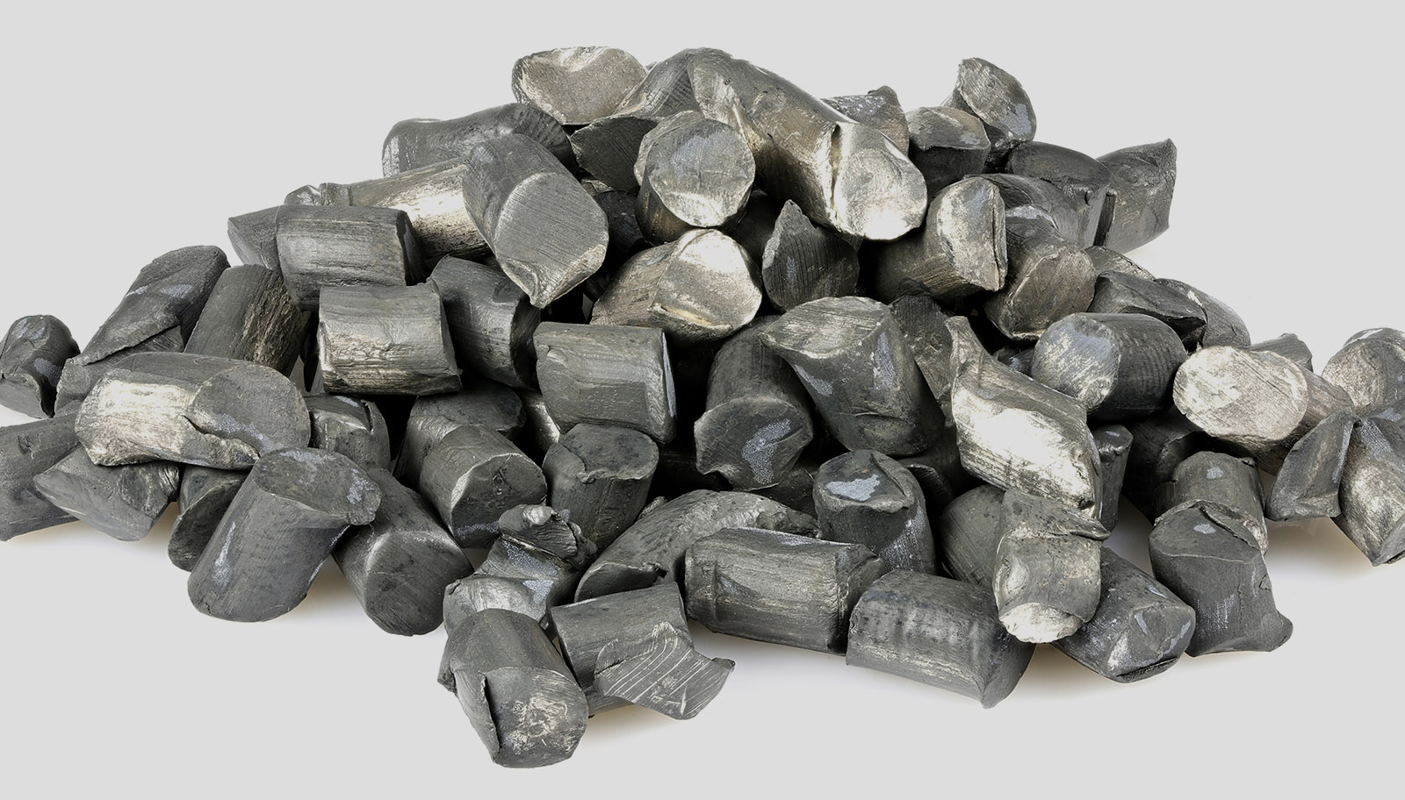
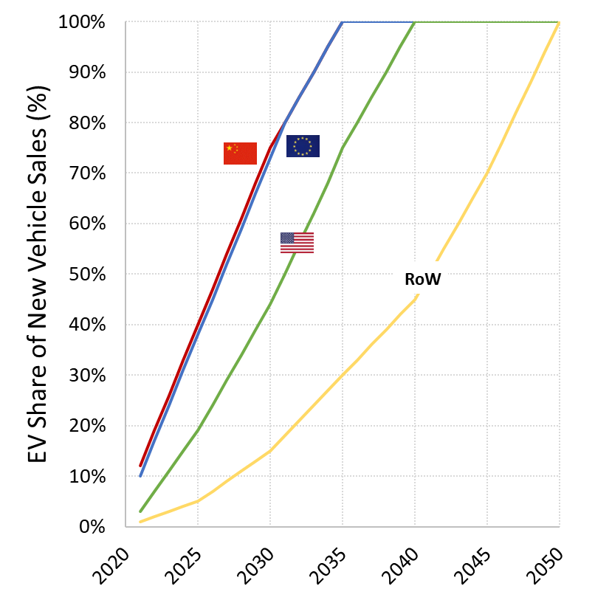
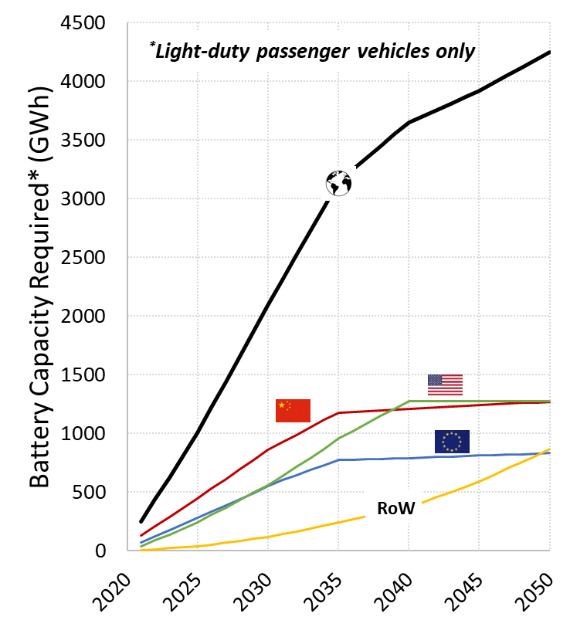
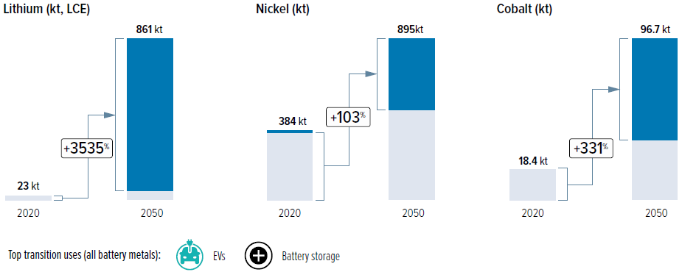
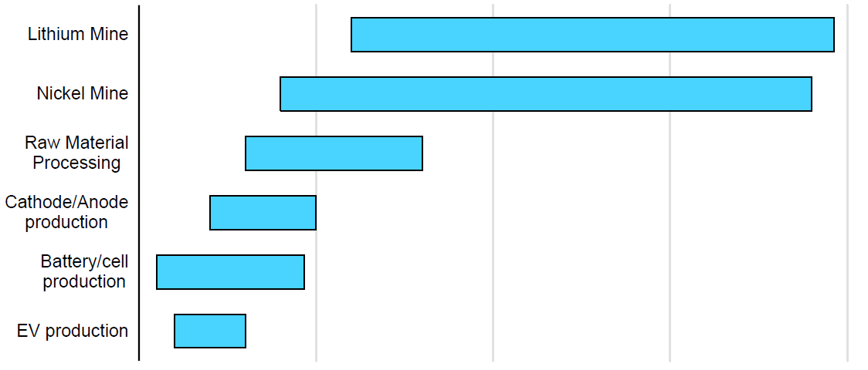
Battery raw materials could be a bottleneck for EVs in the next few years
EV share (light-duty)
Battery demand for LD
Raw materials
+ HD, consumer electronics, energy storage …
Future needs for EU alone
Li : 36X Ni : 2X Co : 4X
Global capacity
Recycling, new chemistries, smaller batteries…
“Metals for Clean Energy: Pathways to solving Europe’s raw materials challenge” Eurometaux, 2022
Mines cannot be built overnight
Assumptions
Avg. battery pack sizes – 50 kWh in China, 60 kWh in Europe, 75 kWh in US
Vehicle sales flat in US and grow at 0.5% per year in all other regions
No separation of PHEV and BEV for simplicity
0
10
20
Years for mine development

Slide 16
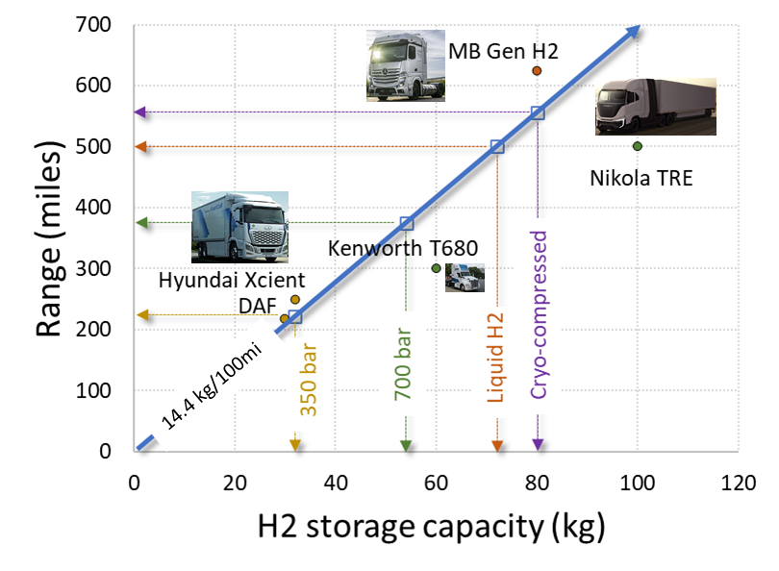
H₂ fuel cell vehicles are suited for long-haul (range, quick refueling)
Need to address green H₂ availability and infrastructure
H₂ density (g/L) 16 27 36 40
We will need a lot of (green) H₂ …
For ~ 0.5M long-haul trucks (25% of fleet today) running 350 mi per day
H₂ annual requirement =
500,000 x 350mi x 365 day/yr x 0.144 kg-H₂/mi
= ~ 9.2M tons
US total H₂ demand today is 10M tons per year (NREL), almost all made from fossil fuels

Slide 17


How much can we improve the internal combustion engine ?
ST = SuperTruck (DOE program)
ST 2 target
ST2 : 14 mpg (projected)
-35% fuel consumption
2019 production: 9 mpg
Brake Thermal Efficiency (%)
2009 baseline : 5.8 mpg
Detroit DD15 : BTE 48%
Daimler, 42nd Intl. Vienna Motor Symposium, 2021
3.4% lower fuel consumption
Meets 2024 GHG requirements
Compliance to 435,000 mi
NOx reduction by 60% on FTP
1960
1970
1980
1990
2000
2010
2020
Year
Navistar, Book chapter in “Alternative Fuels and Advanced Vehicle Technologies for Improved Environmental Performance”, 2014
doi: 10.1533/9780857097422.2.225

Slide 18













Super-Truck II : 55% BTE & 2X freight efficiency
https://www.energy.gov/eere/vehicles/annual-merit-review-presentations
Improved combustion
High CR + 0.3 – 0.8 BTE
Thermal barrier coatings - 1 % BSFC
Lower friction +0.5% BTE
Model-based control
Weight reduction
Navistar: ~ 4,000 lbs (trailer, frame)
Cummins: ~4,700 lbs (+ trailer solar panels)
PACCAR: 28%
Aerodynamics & tires
Aero drag reduced by ~ ~60% by NAV, Kenworth, Cummins, PACCAR
Rolling R : NAV 22% ↓, Cummins 33% ↓
VEHICLE
Improved air handling
EGR pump (+0.9 BTE)
Miller cycle LIVC
High efficiency turbochargers
Eaton
SuperTruck2
55% BTE
2X freight η
ENGINE
Improved after-treatment
Low ΔP design
cc-SCR, high cell density, thin wall
TRANSMISSION, ELECTRIFICATION
Navistar
48V mild hybridization, 7 – 15 kWh Li-ion battery. Electrification: HVAC, P-steering, coolant pumps, CAC, e-hoteling, etc.
Waste heat recovery
~ +3 – 4.5% BTE
ORC with cyclopentane
Dual entry turbine
Predictive cruise control
Navistar
Cummins

Slide 19



Vocational trucks: Combining high efficiency engine with mild-hybridization could reduce CO₂ > 30% beyond model year 2027
P3 mild hybrid for vocational truck
~ 24% reduced fuel consumption at reduced TCO
ICCT White Paper, Nov 2021
Class 6-7 vocational
7L engine, 49% BTE beyond MY2027
+34% efficiency @ +$17,400
(All tech. have a < 2 yr. payback)
Fuel Consumption Reduction
Simulations using EPA GHG emission model (GEM)
FEV SAE 2021-01-0720 doi:10.4271/2021-01-0720

Slide 20




H₂ combustion – why ?!
Well-to-wheel CO₂ reduction vs. diesel
TCO parity needs significant H₂ price reduction
Utilization of existing hardware
Biomethane
H₂-ICE
TCO much lower than fuel cell vehicle
- Lower than diesel with higher fuel prices ?
Carry over existing hardware from diesels
H₂
€8/kg
€4/kg
40% blend
Service
Fuel
Blue H₂
Tires
Peak BTE 45% (similar to diesel) – but with 99% lower NOx
Driver
80% Blue-20% green H₂
100% biomethane
Green H₂
Truck
Truck cost Diesel truck : €110K, H₂ ICE : 1.3 – 1.4X, FCEV : 2.6 – 3.4X
Fuel cost Diesel : €1.5/liter, H₂ : €6/kg
Driver cost : €60K/yr
Westport Fuel Systems
43rd Intl. Vienna Motor Symposium, 2022
MAN, 42nd Intl. Vienna Motor Symposium, 2021

Slide 21


Low carbon fuels, fleet turnover will be needed to address decarbonization of existing fleet
Announced capacity by 2025⁽²⁾
US Fuel Consumption (million barrels per day)
Scenario to 2030
US 2021 bio- and renewable diesel production⁽¹⁾
Total ~ 21% of diesel use by 2025
Assume 1.5X growth by 2030
LD : 50% BEVs
Biden goal
3B gal/year of SAF by 2030
Jet fuel
Hybridization – 20% reduced FC
NG
High eff. ICE⁽³⁾ : 30% reduced FC
HD : 15% ZEVs
Gasoline
Diesel
Ethanol
⁽¹⁾ US EIA 2022 Annual Energy Outlook ⁽²⁾Neste, 42nd Intl. Vienna Motor Symposium, 2021 ⁽³⁾SuperTruck2: 55%BTE, mild hybrid, low RR tires, …

Slide 22
We need to pursue all pathways for transport decarbonization
Efficiency improvements
55% BTE, Opposed piston
AchatesPower Opposed Piston engine
Detroit DD15, inline 6-cyl
2024 GHG compliant
ClearFlame Engine
Runs on ethanol
Volvo 7900 hybrid
Alternate fuels
CNG, LPG
Ethanol
Fuel agnostic engines
Hybridization
Mild, full hybrid
ICE
Hybrid + green fuel
H₂ ICE
Plug-in + Syn fuel
Cummins fuel agnostic engines
Fuels
Electrification
Cummins 15L H₂ ICE
Low carbon fuels
Renewable fuels
ZEVs
Battery electrics
Fuel cell vehicles
Synthetic fuels
e-diesel

Slide 23
Thank you !
  Contact Info
joshia@corning.com
https://www.linkedin.com/in/joshiav/

